Slide 1
CSE101-Lec#2
Programming Methodologies
C Program Development Environment
Algorithm and Pseudo code

Slide 2
Outline
Program Development in C
Structured programming (Algorithm and Pseudocode)

Slide 3
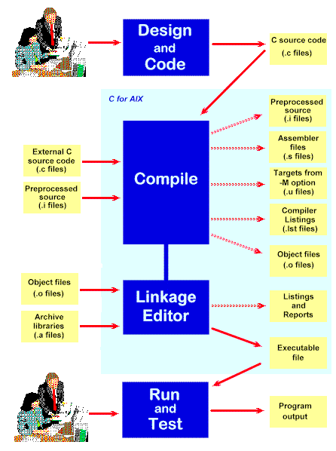
C Program Development Environment
A C program must go through various phases such as:
  Creating a program with editor
  Execution of preprocessor program
  Compilation
  Linking
  Loading
  Executing

Slide 4
Editor
Program is created in
the editor and stored
on disk.
Disk
Preprocessor
Disk
Preprocessor program
processes the code.
Compiler creates
object code and stores
it on disk.
Compiler
Disk
Linker links the object
code with the libraries,
Linker
Disk
Primary Memory
Loader
Loader puts program in memory.
Disk
.
.
.
.
.
.
Primary Memory
CPU
CPU takes each
instruction and
executes it, possibly
storing new data
values as the program
executes.
.
.
.
.
.
.

Slide 5
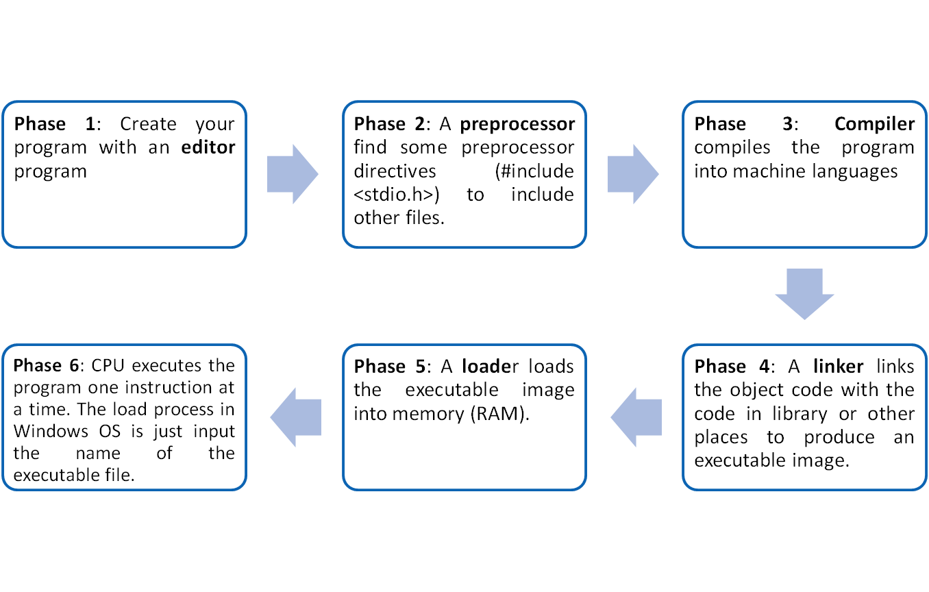
C Program Development Environment(cont.)

Slide 6
Program Development Tools
Algorithm
Flow chart
Pseudo-code

Slide 7

Algorithm
Algorithm is defined as “ the finite set of steps, which provide a chain of action for solving a problem”
It is step by step solution to given problem.
Well organized, pre-arranged and defined textual computational module
Quick yak:
Various daily routine algorithms can be shared
Deciding on an Ice cream out of a lot
Chapati selection

Slide 8
Characteristics of good Algorithm
Correctness - terminates on ALL inputs (even invalid inputs!) and outputs the correct answer.
Simplicity - each step of the algorithm performs one logical step in solving the problem.
Precision - each step of the algorithm is unambiguous in meaning.
Comprehensibility - the algorithm is easy to read and understand.
Abstraction - presents the solution steps precisely and concisely without referring to low-level (program code) details.
Efficient - Gives results rapidly based on the problem size; does not waste any space or time.
Easy to Implement - relatively easy to translate into a programming language.

Slide 9
Steps to create an Algorithm
1. Identify the Inputs
What data do I need?
How will I get the data?
In what format will the data be?
2. Identify the Outputs
What outputs do I need to return to the user?
What format should the outputs take?
Quick yak:
Formulate examples on conversation…
Ask a question
When would you be 34 years old
Let them craft a logic for answer!!!

Slide 10
Steps to create an Algorithm
3. Identify the Processes
How can I manipulate data to produce meaningful results?
Data vs. Information
4. Break the Solution to steps
By breaking the solution to the steps we can easily understand the logic of program

Slide 11

Example of Algorithm
To establish a telephone communication
Step 1: Dial a phone number
Step 2: Phone rings at the called party
Step 3: Caller waits for the response
Step 4: Called party picks up the phone
Step 5: Conversation begins between them
Step 6: After the conversation, both disconnect the call

Slide 12
Algorithm: Add 2 Numbers
Problem: To add two numbers.
Step1. Start.
Step2. Take the two numbers.
Step3. Add them.
Step4. Print the result.
Step5. Stop.

Slide 13
Pseudocode
Pseudocode is similar to everyday English language, its convenient and user friendly
It’s not a actual computer programming language.
Pseudocode consist only of action statements
In pseudocode representation
  Each of steps will be written via operators and statements equivalent to some programming language instructions.
  The only difference will be that the exact syntax of the programming language will not be followed.

Slide 14
Pseudo code: Add 2 Numbers
Set A = 4.
Set B = 2.
Calculate Sum = A + B.
Print Sum.

Slide 15
Flow Chart
Flow Chart is pictorial representation of an algorithm.
Whatever we have done in algorithm we can represent it in picture.
It is easy to understand.
Shows the flow of the instruction

Slide 16
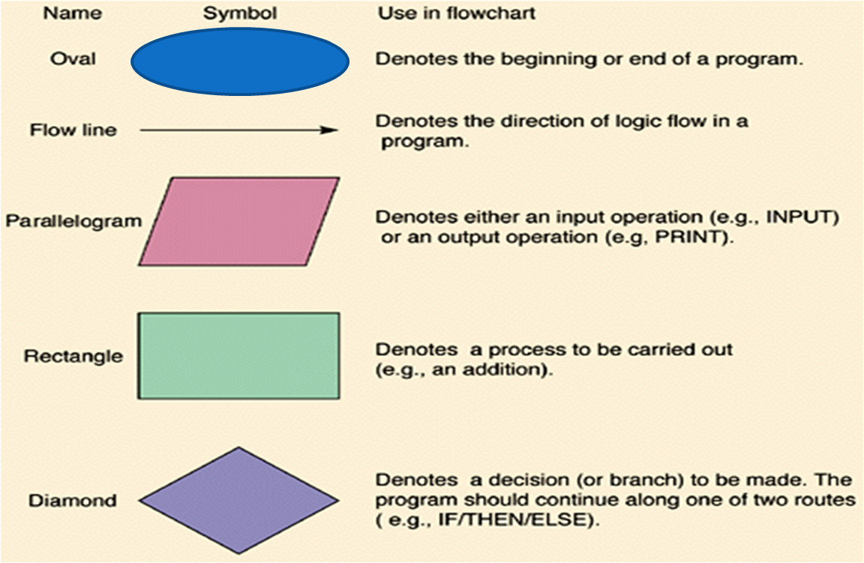
Flow Chart Symbols

Slide 17
Explanation
A simple C program consists of
  Comments (optional)
    //
    /*….*/
  Including header files
    #include<header file name>
    -variables
  Functions
    main function as special function
    Other user defined functions (optional)
Let’s discuss these in detail..

